Slide 1

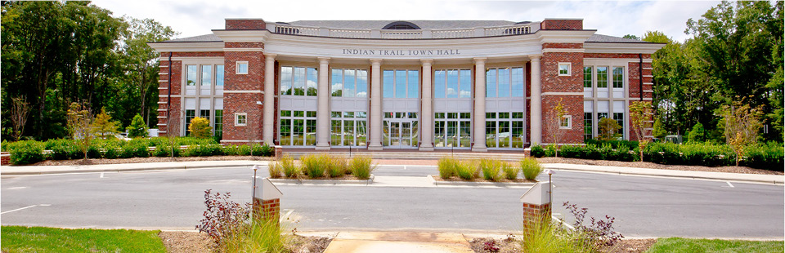
INDIAN TRAIL COMPLETE STREET
JUNE 12, 2025

Slide 2

IT COMPLETE STREET PHASE 1
DISCUSSION ITEMS:
Project Update
Amendments to CIP Ordinance
www.indiantrail.org

Slide 3
PROJECT UPDATE
CURRENT ACTIVITIES:
NCDOT Submittals
Water and Sewer Plans
Utility Coordination w/ Third-Party Providers
www.indiantrail.org

Slide 4
NCDOT SUBMITTALS
R/W Certification
R/W Reimbursement
Construction Authorization
www.indiantrail.org

Slide 5
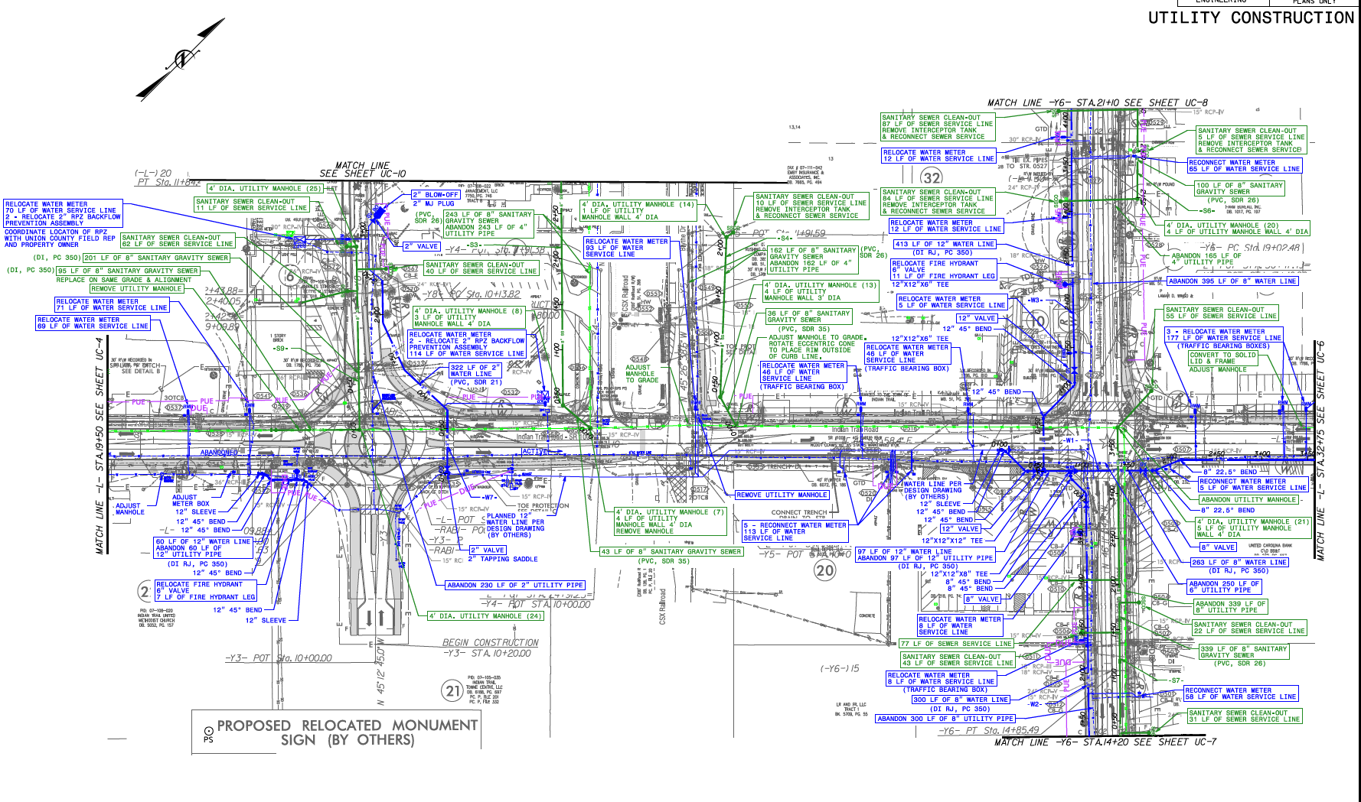

Slide 6
WATER AND SEWER PLANS
County finished final review
Address minor comments
Submit to NCDOT
www.indiantrail.org

Slide 7
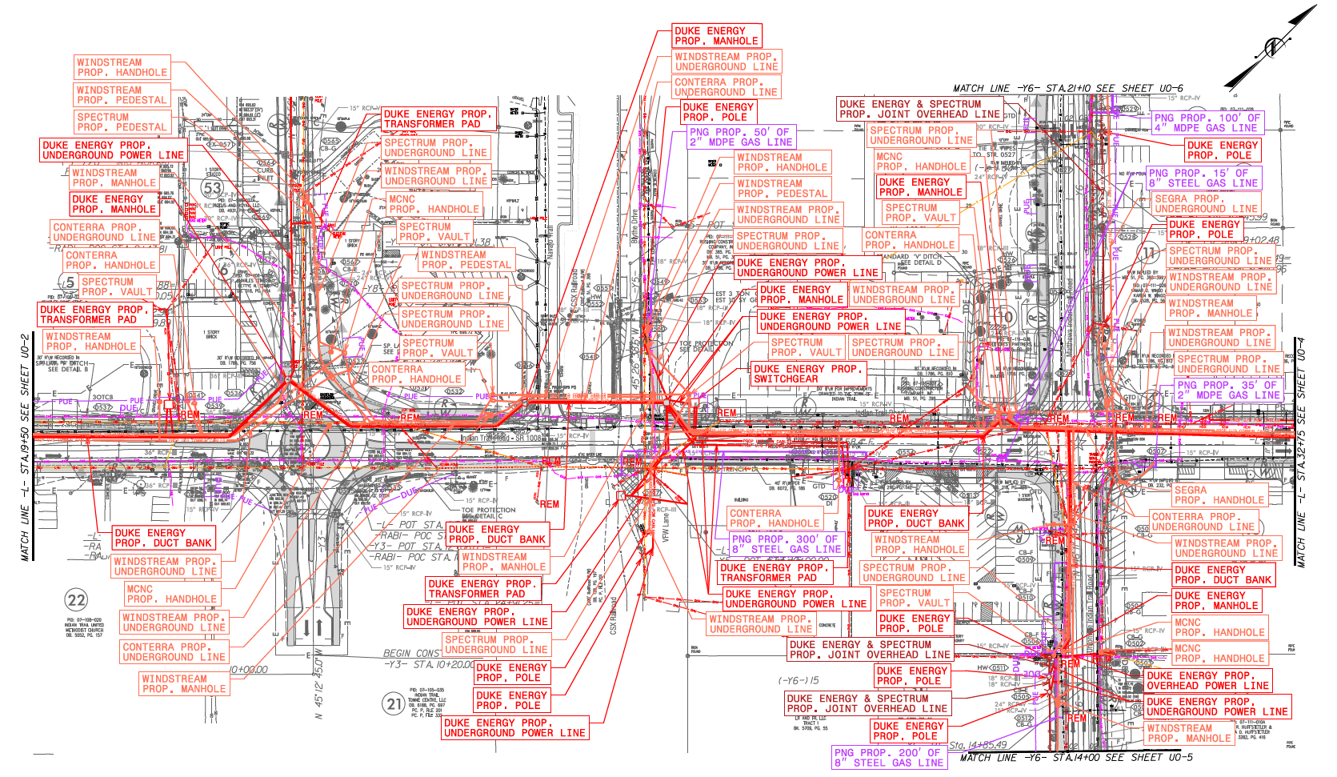

Slide 9
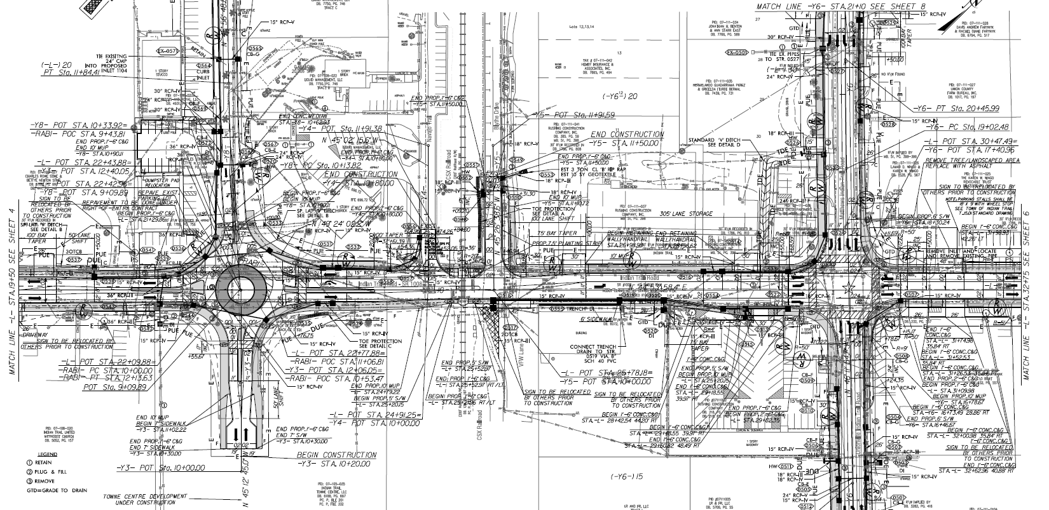

Slide 10
IT COMPLETE STREET PH 1
Union County Water and Sewer Design:
County Portion = $1,500,000.00
Town Portion = $500,000.00 (reimbursable)
TOTAL = $2,000,000.00
Note: County pays 100% for their portion.
www.indiantrail.org

Slide 11
THIRD-PARTY UTILITIES
Follow Up Coordination Meetings
Finalizing one design
Conduit Count and Color Scheme
www.indiantrail.org

Slide 12
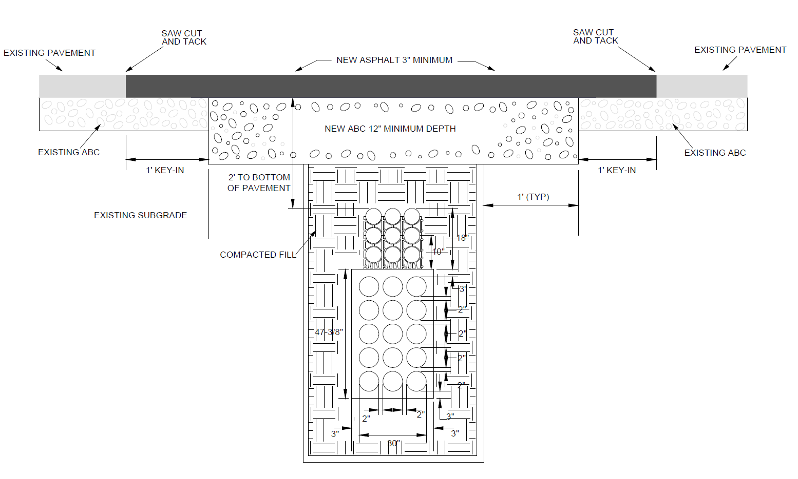

Slide 13
AMENDMENT TO ORDINANCE
UTILITIZE THE REST OF SCIF GRANT FUNDS FOR THE FOLLOWING:
Design Coordination
R/W Acquisition
Construction/Betterments
www.indiantrail.org

Slide 14
DESIGN COORDINATION
Roadway Design (EC, Stormwater, Traffic, Paving, Etc.)
Signal Design
Utility Design
UBO Coordination
www.indiantrail.org

Slide 15
R/W ACQUISITION
CURRENT R/W FUND = $2,500,000.00
FUNDS NEEDED = $53,000.00+
RECENT ACQUISITION = $30,000.00
ADDITIONAL FUND REQUEST = $100,000.00
www.indiantrail.org

Slide 16
CONDEMNATION UPDATES
No. | PARCEL NUMBERS | STATUS OF CONDEMNATION
1 | PARCEL 5 | COMPLAINT FILED, MEDIATION TO OCCUR NEXT
2 | PARCEL 6 | COMPLAINT FILED, MEDIATION TO OCCUR NEXT
3 | PARCEL 7,47 | COMPLAINT FILED, MEDIATION TO OCCUR NEXT
4 | PARCEL 18 | COMPLAINT FILED, MEDIATION TO OCCUR NEXT
5 | PARCEL 24,45 | COMPLAINT FILED, MEDIATION TO OCCUR NEXT
6 | PARCEL 25,26,27 | SETTLED
7 | PARCEL 30 | COMPLAINT FILED, MEDIATION TO OCCUR NEXT
8 | PARCEL 33 | COMPLAINT FILED, MEDIATION TO OCCUR NEXT
9 | PARCEL 37 | COMPLAINT FILED, MEDIATION TO OCCUR NEXT
10 | PARCEL 54,55 | COMPLAINT FILED, MEDIATION TO OCCUR NEXT
www.indiantrail.org

Slide 17
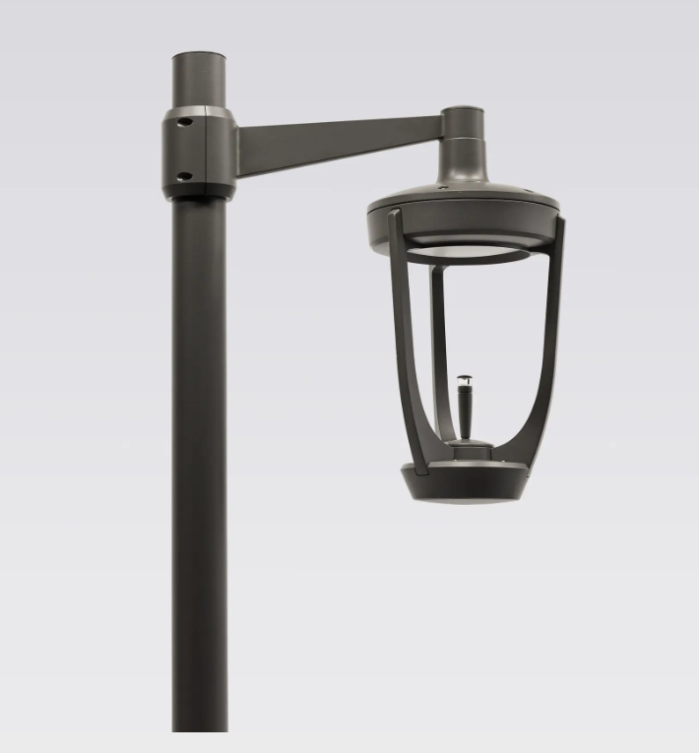
CONSTRUCTION/BETTERMENTS
STREETLIGHTS
www.indiantrail.org

Slide 18
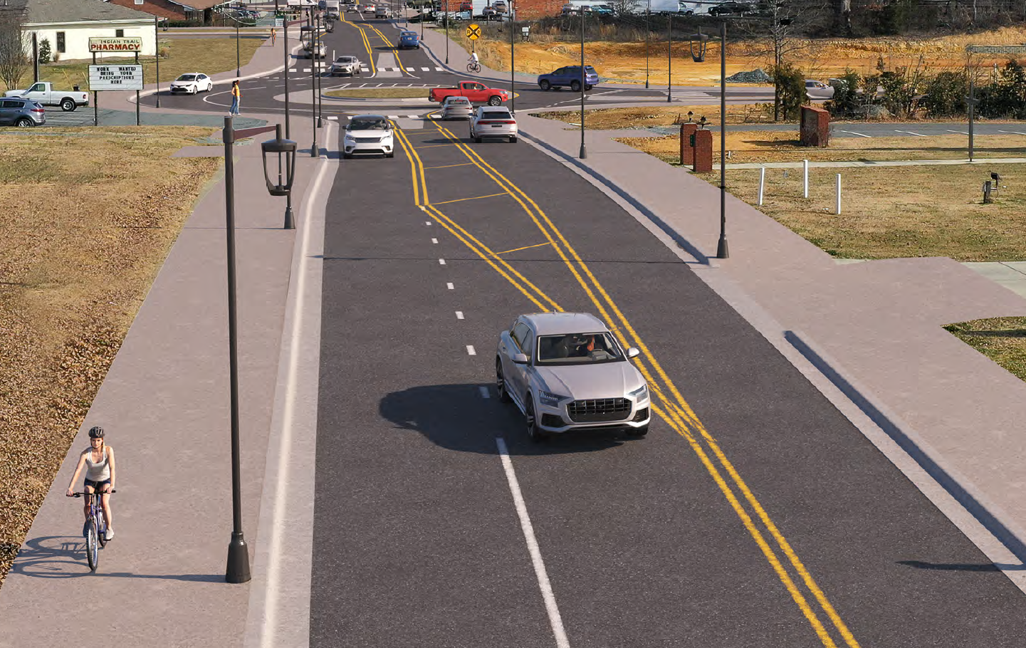

Slide 19
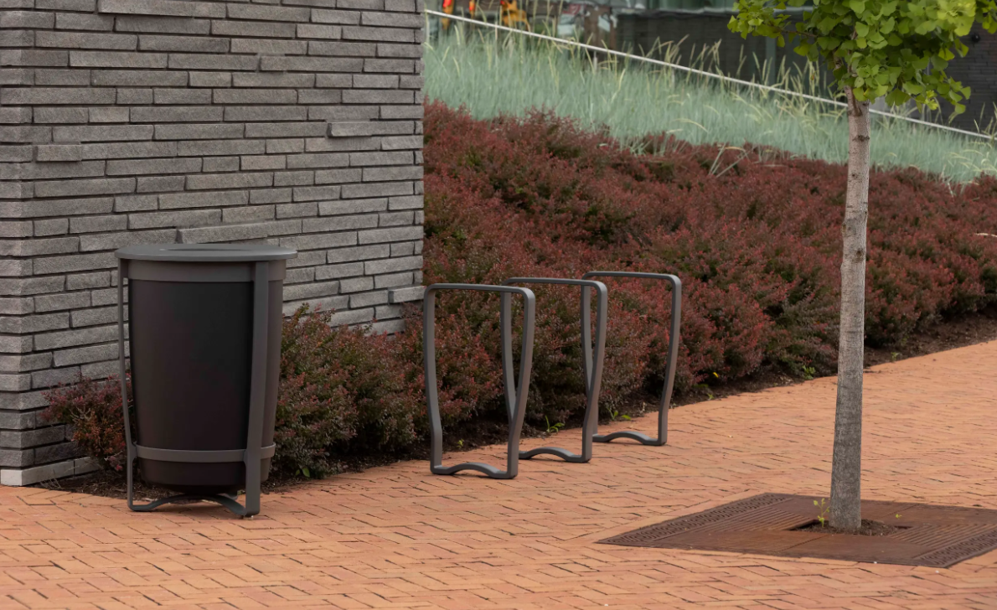
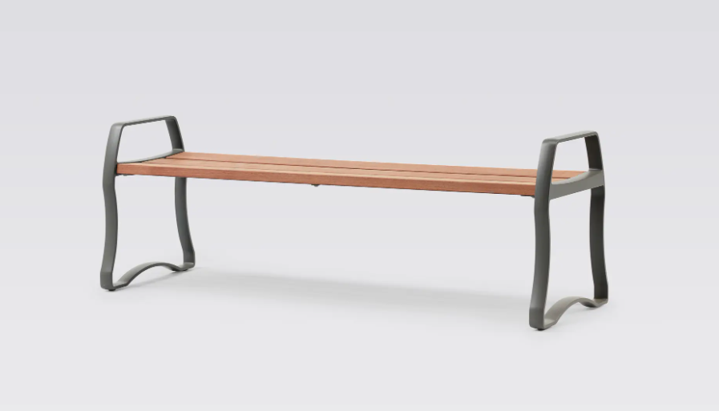
CONSTRUCTION/BETTERMENTS
FURNISHINGS
www.indiantrail.org

Slide 20
CONSTRUCTION/BETTERMENTS
STREETLIGHTS = $650,000.00
FURNISHINGS = $60,000.00
SIGN RELOCATION = $220,000.00
ADDITIONAL FUND REQUEST = $930,000.00
NOTE: Tariffs (Electronic Drivers and LED Diodes)
www.indiantrail.org

Slide 21
CONSTRUCTION/BETTERMENTS
Additional Utility Work (beyond Project limits)
www.indiantrail.org

Slide 22
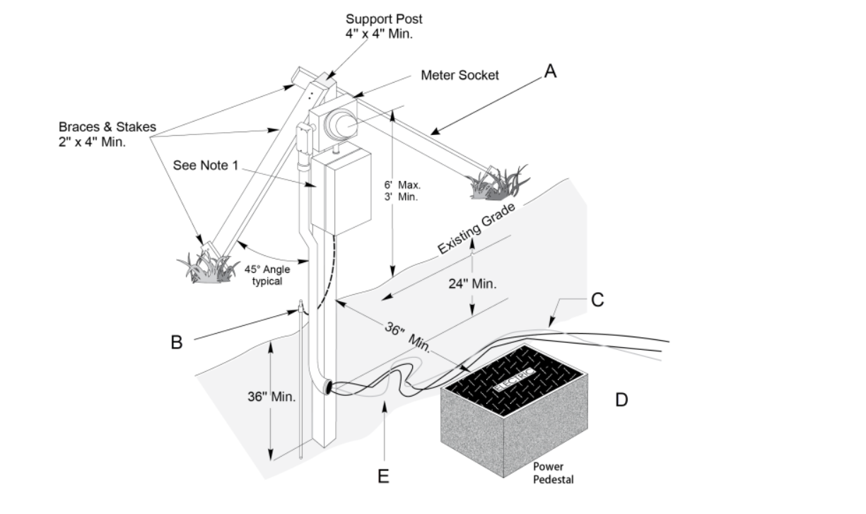

Slide 23
AMENDMENT TO ORDINANCE
ITEM DESCRIPTION | GRANT BREAKDOWN
DESIGN COORDINATION | $66,919.00*
R/W ACQUISITION ONGOING COSTS | $100,000.00
CONSTRUCTION | $903,081.00
STREETSCAPE AMENITIES | $930,000.00
TOTALS = | $2,000,000.00
*NOTE: ARBITRARY NUMBER VALUE
www.indiantrail.org

Slide 24
AMENDED ORDINANCE
ITEM DESCRIPTION | PREVIOUS VALUES | $2.0 MIL BREAKDOWN | NEW VALUES
DESIGN | $983,081.00 | $66,919.00* | $1,050,000.00
RIGHT OF WAY | $2,500,000.00 | $100,000.00 | $2,600,000.00
CONSTRUCTION | $13,572,281.00 | $903,081.00 | $14,475,362.00
STREETSCAPE AMENITIES | $50,000.00 | $930,000.00 | $980,000.00
TOTALS = | $17,105,362 | $2,000,000 | $19,105,362
**NOTE: ARBITRARY NUMBER VALUE
www.indiantrail.org

Slide 25
Project Budget
FUNDING SOURCES |  | FUNDING AMOUNTS
ATRIUM CONTRIBUTION |  | $1,174,000.00
TOWN CENTER CONTRIBUTION |  | $1,350,000.00
2021 STREET BOND |  | $1,142,000.00
GENERAL FUND |  | $438,385.00
CRTPO FUNDING |  | $7,950,977.00
NC DEPT. OF COMMERCE GRANT |  | $50,000.00
NC SCIF GRANT |  | $7,000,000.00
 | TOTAL: | $19,105,362.00
www.indiantrail.org

Slide 26
IT Complete Street Update
Questions
www.indiantrail.org

Slide 27
FEDERAL FUNDS BREAKDOWN
ITEM DESCRIPTION | PREVIOUS AWARDED FUNDS | NEWLY AWARDED FUNDS | TOTAL AVAILABLE FUNDS
RIGHT OF WAY | $1,509,000.00 | $330,400.00 | $1,839,400.00
CONSTRUCTION | $5,739,000.00 | $1,321,600.00 | $7,060,600.00
TOTALS = | $7,248,000 | $1,652,000 | $8,900,000
**IMPORTANT** - ADDITIONAL AGENCY LIABILITY = $723,000.00
www.indiantrail.org

Slide 28
PROJECT ACTIVITIES
ITEM DESCRIPTION
ROADWAY
TRAFFIC SIGNALS
WATER AND SEWER
TRAFFIC CONTROL
4TH LEG OF ROUNDABOUT
www.indiantrail.org

